Slide 1
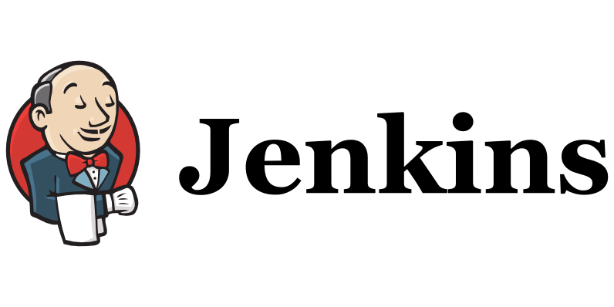

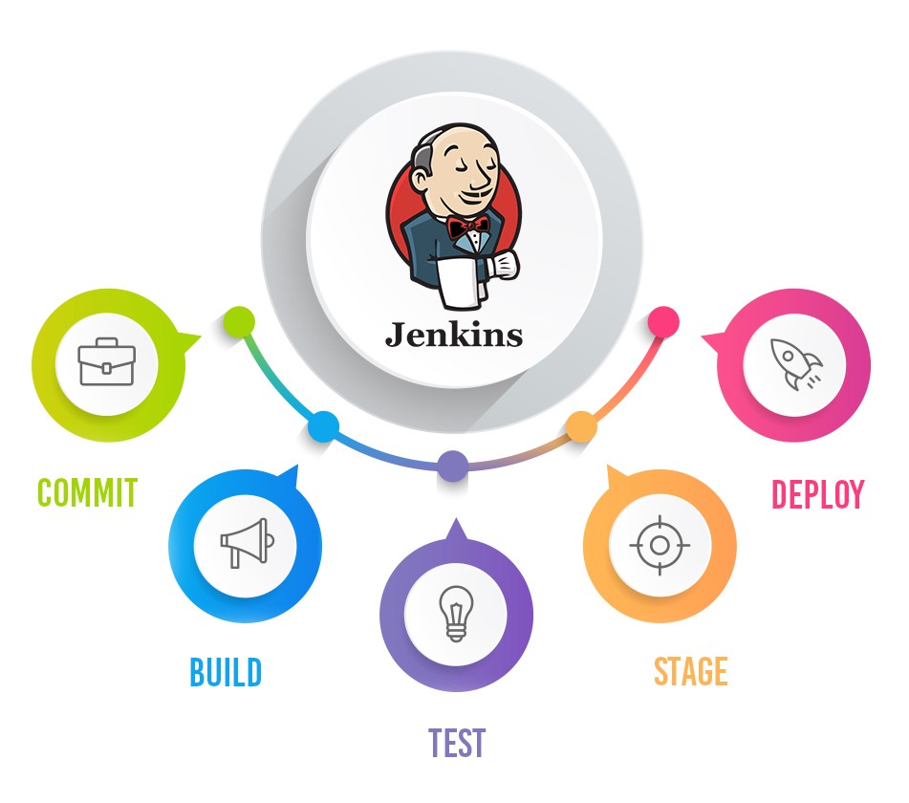
Maven not found in Jenkins
Pramod Dutta
How to Fix MVN not found in Jenkins

Slide 2
Agenda
How to Fix MVN not found in Jenkins

Slide 3
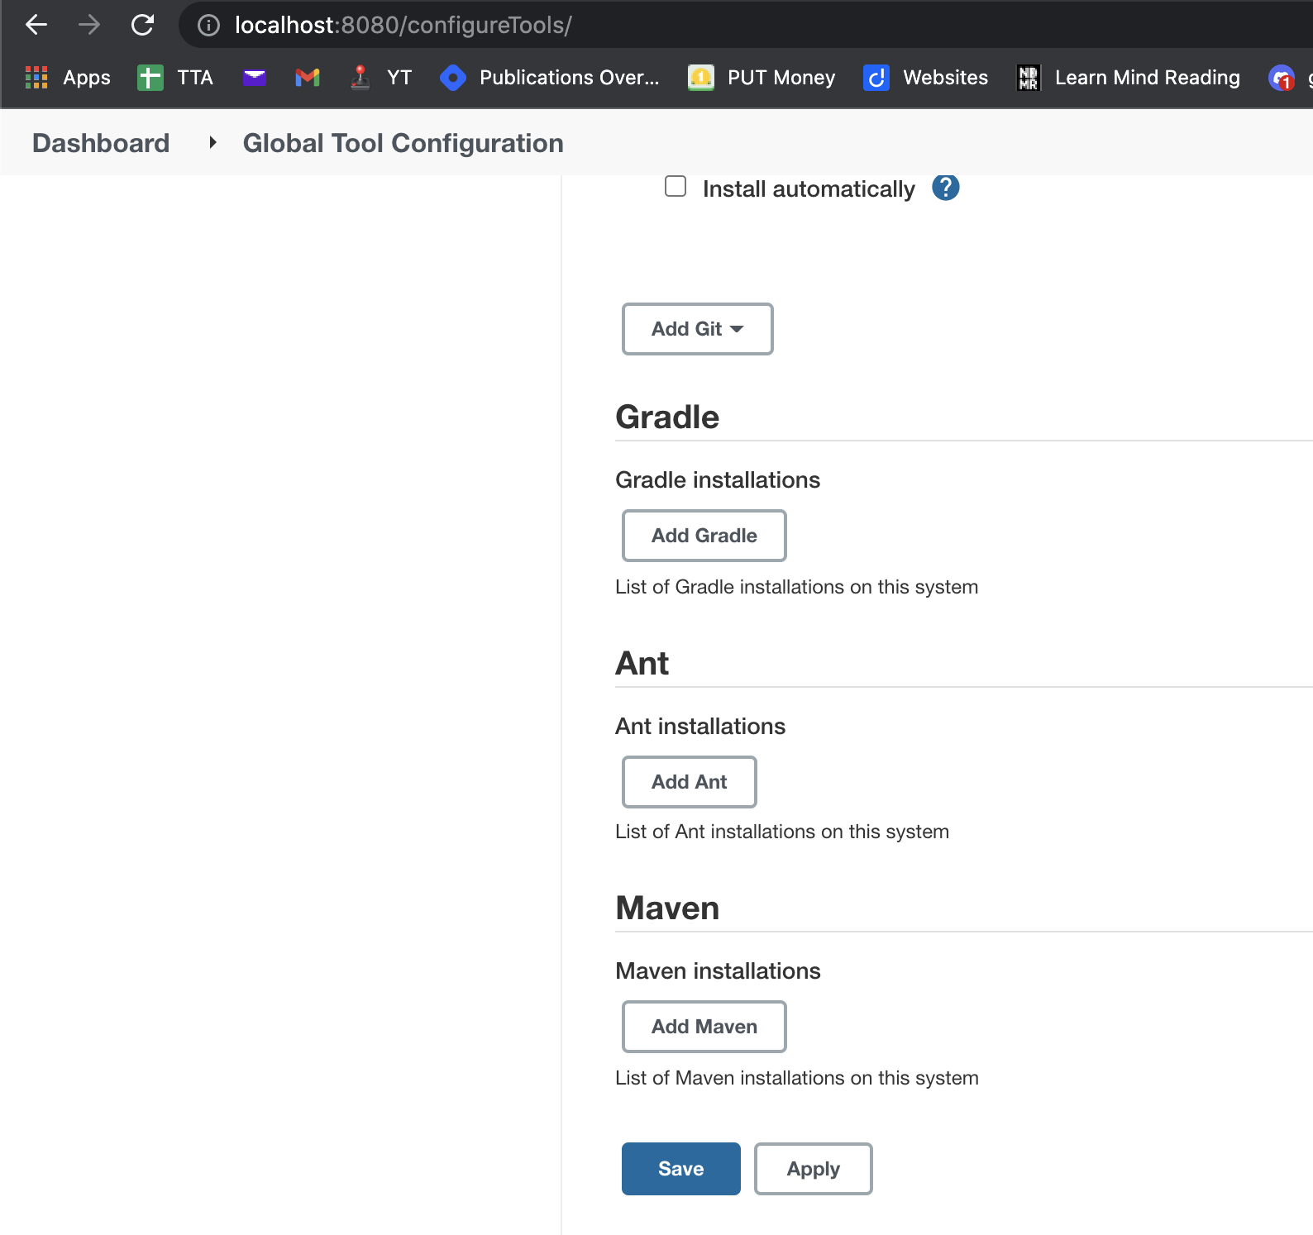
PROBLEM
We are running Maven project but we get
Maven command not found

Slide 4
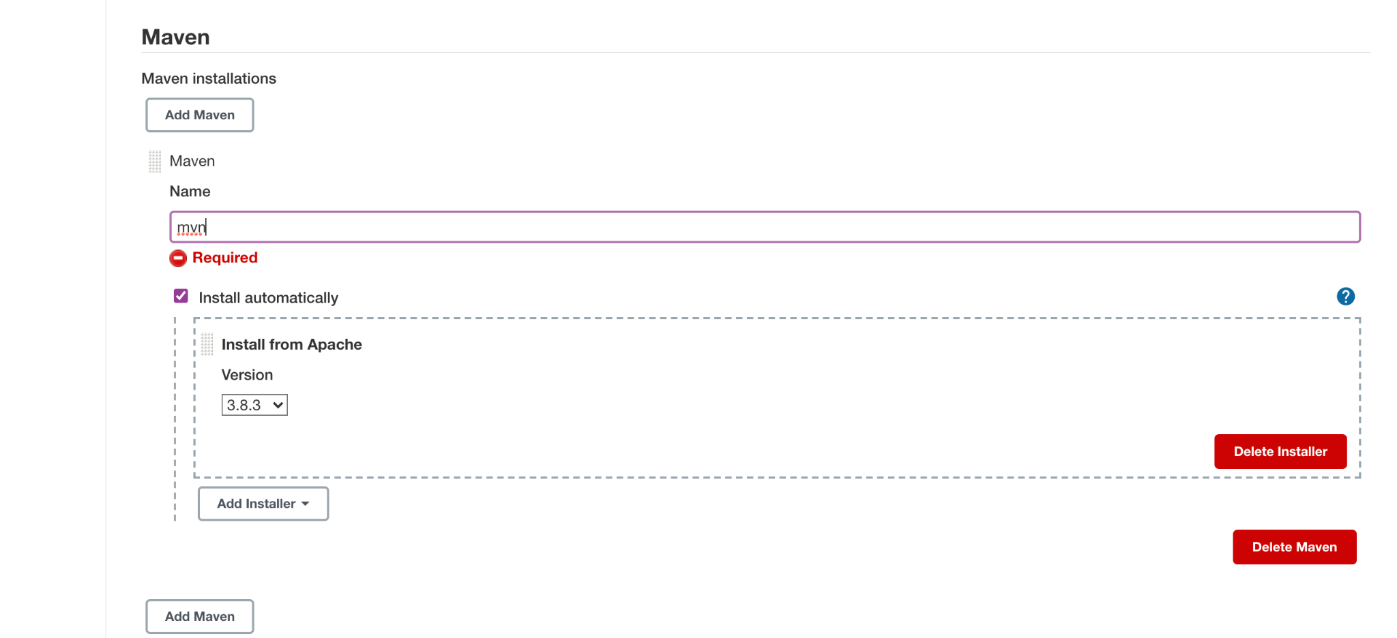
Solution
We are running Maven project but we get
Maven command not found

Slide 5
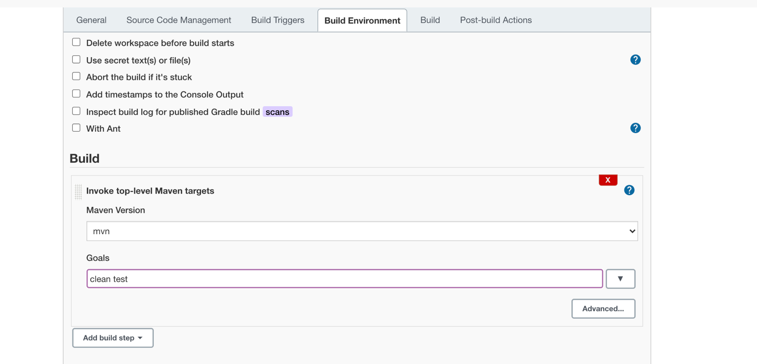
Solution
We are running Maven project but we get
Maven command not found

Slide 6
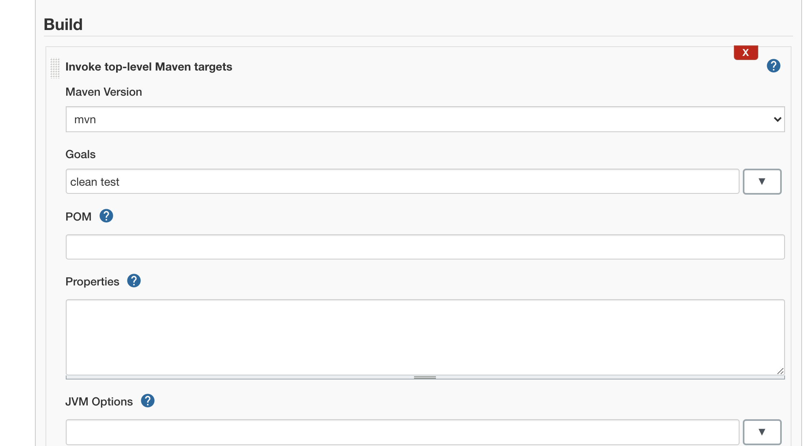
Solution
We are running Maven project but we get
Maven command not found

Slide 7

Lets See Jenkins Job Demo
Demo Jenkins job

